Slide 1


NLP
Sentiment analysis
HARPE
DATA
SCIENCE

Slide 2

Sample size?
R simulation

Slide 3
NLP basics
HARPE
DATA
SCIENCE

Slide 4
T-test
R Bootcamp
2.5

Slide 5
Regression
R Bootcamp
2.4

Slide 6
Correlation
R Bootcamp
2.3

Slide 7
Distributions
R Bootcamp
2.2

Slide 8
summarizing
data
R Bootcamp
2.1
HARPE
DATA
SCIENCE

Slide 9
HAP-E
Machine learning
concept
HARPE
DATA
SCIENCE

Slide 10
HAP-E
Stats basics
HARPE
DATA
SCIENCE

Slide 11
HAP-E
Data wrangling
HARPE
DATA
SCIENCE

Slide 12
HAP-E
Python graphs
HARPE
DATA
SCIENCE

Slide 13

HAP-E
Python setup
HARPE
DATA
SCIENCE

Slide 14
manipulating
data
R Bootcamp
1.5
HARPE
DATA
SCIENCE

Slide 15
R Bootcamp
1.4
HARPE
DATA
SCIENCE

Slide 16
R Bootcamp
1.3
HARPE
DATA
SCIENCE

Slide 17

Github
Website
HARPE
HARPE
DATA
SCIENCE
SCIENCE

Slide 18


R Bootcamp
0.0 overview
HARPE
HARPE
DATA
SCIENCE
SCIENCE

Slide 19

R Bootcamp
0.1 RStudio
HARPE
HARPE
DATA
SCIENCE
SCIENCE

Slide 20
R Bootcamp
1.1 R Syntax
HARPE
HARPE
DATA
SCIENCE
SCIENCE

Slide 21
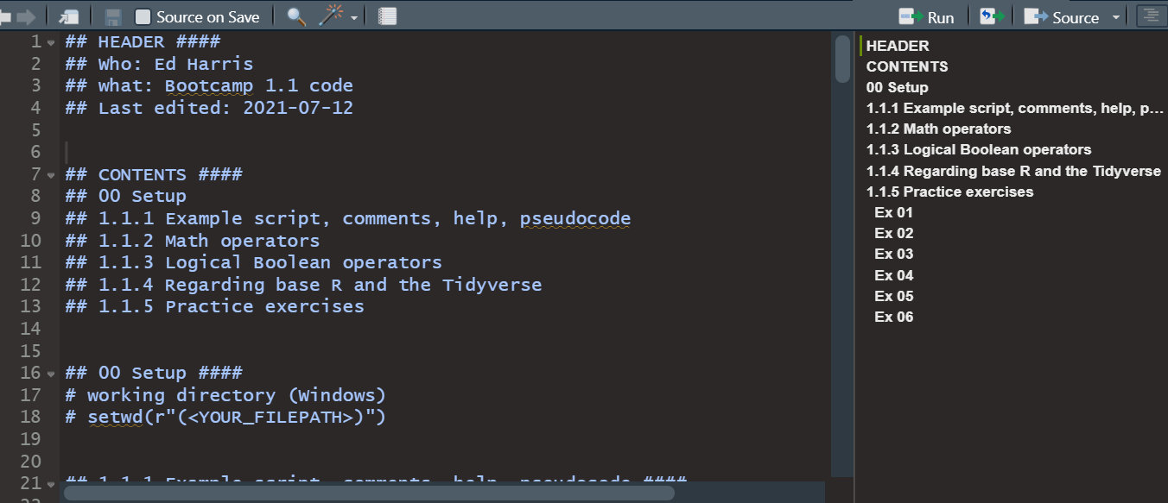
R Bootcamp
1.1 R Syntax
HARPE
HARPE
DATA
SCIENCE
SCIENCE

Slide 22
R Bootcamp
1.2 Functions
HARPE
HARPE
DATA
SCIENCE
SCIENCE

Slide 23
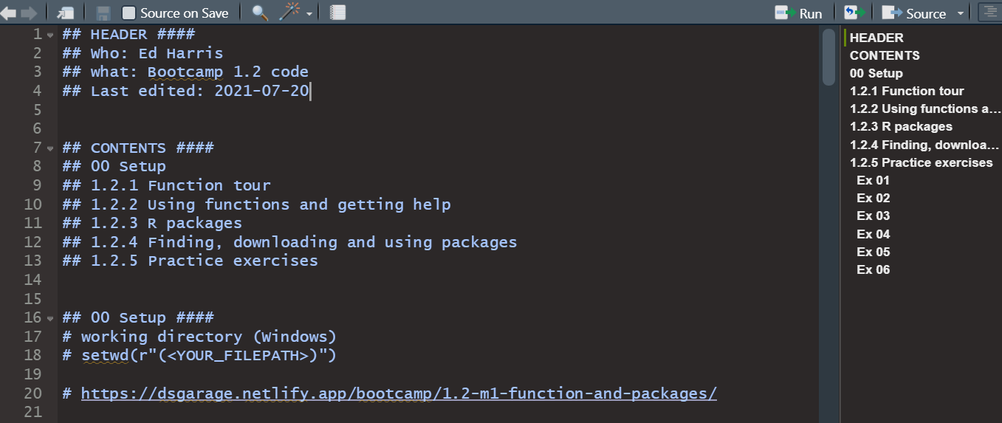
R Bootcamp
1.2 Functions
HARPE
HARPE
DATA
SCIENCE
SCIENCE

Slide 24


Q
C7081
2021
antine

Slide 25
Q
antine
Q
antine

Slide 26


HARPE
D
D
HARPE
HARPE
T
T
A
A
2021
HA UG!
D
HARPE
T
2021
A

Slide 27
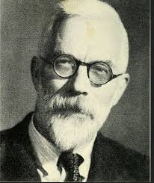

HARPE
HARPE
DATA
SCIENCE
HARPE
HARPE
DATA
SCIENCE

Slide 28


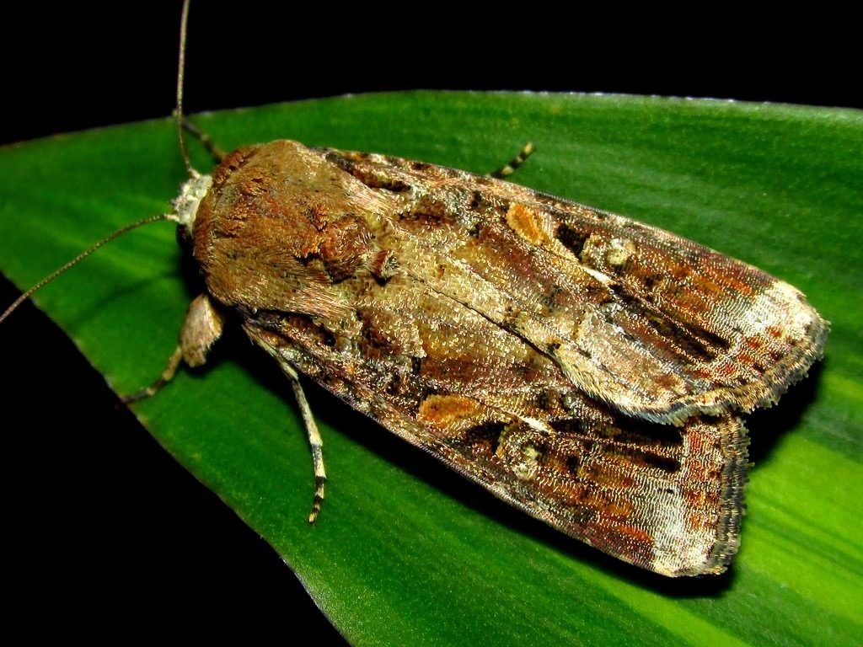























DS
EDA
2021
GA
AGE
DS
2021
DATA
SCIENCE
DS
GA
AGE

Slide 30

shinycustomloader
shinycustomloader
shinycustomloader
shinycustomloader
shinycustomloader
shinycustomloader
shinycustomloader
shinycustomloader
http://hexb.in/sticker.html

